Slide 1
PROBLEM STATEMENT
Images are one of the major sources of data in the field of data science and AI. This field is making appropriate use of information that can be gathered through images by examining its features and details. We are trying to give you an exposure of how an end to end project is developed in this field.
The idea behind this project is to build a deep learning-based Image Classification model on images that will be scraped from e-commerce portal. This is done to make the model more and more robust.
This task is divided into two phases: Data Collection and Mode Building.
PROBLEM UNDERSTANDING
E-commerce industry is fast growing in worldwide. Amazon Company is leading in market in India where they are providing wide range of assortment and choices for customer. For any E commerce company designing the apps and content in apps about the product information play very vital role. Company has to depend on suppliers to get the product images and their details. To have correct information from supplier NLP algorithm plays very important role where the algorithm can predict the correct category of product by processing the images of product.

Slide 2
EDA STEPS FINALIZED MODEL AND CONCLUSION
Scrapping data .
Data Preprocessing.
Model Development and Evaluation
Conclusion

Slide 3
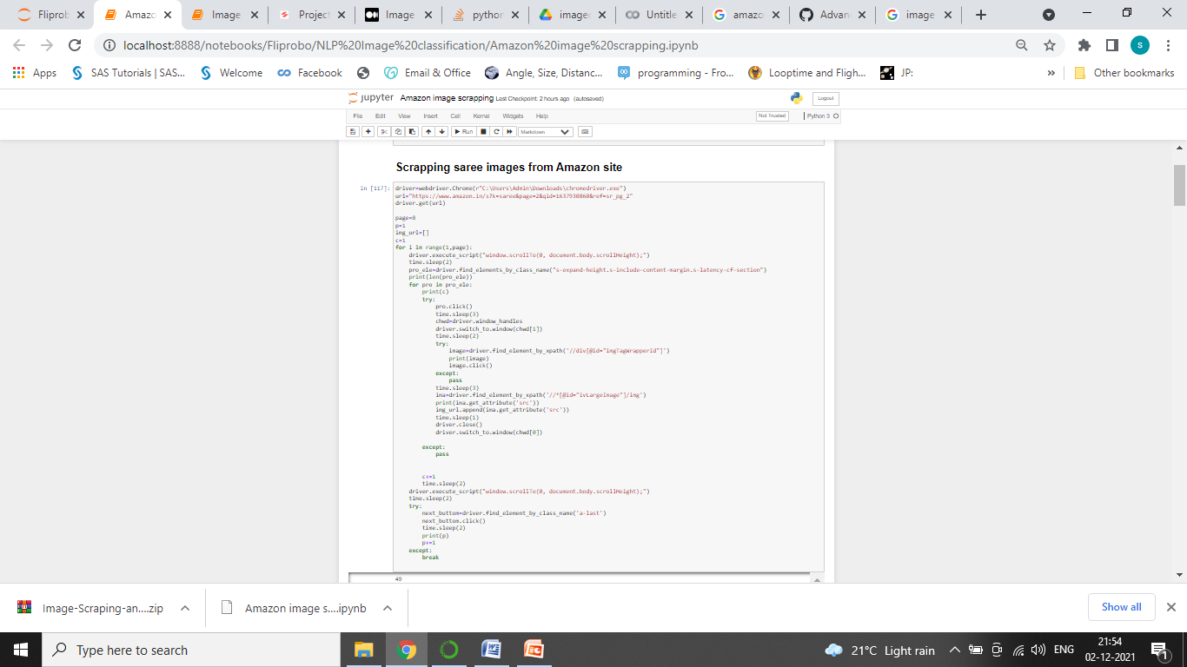
Scrapping data.

Slide 4
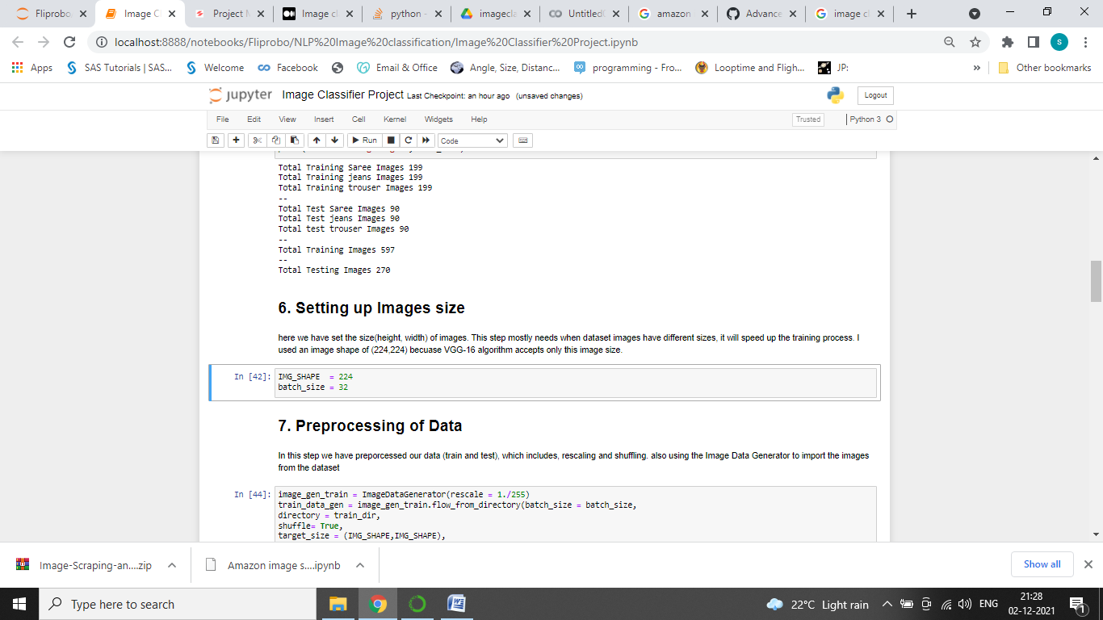
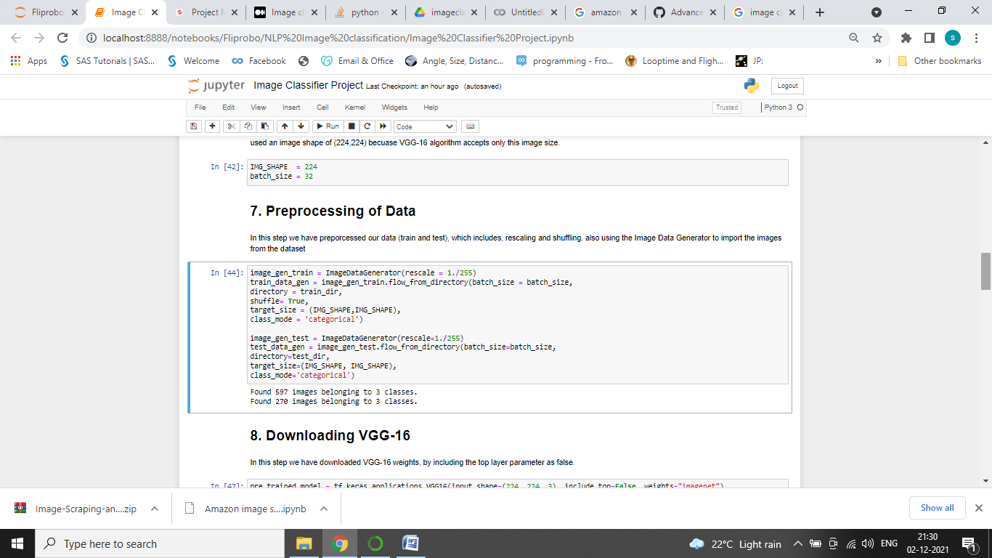
Data Pre Processing.
Following are the step followed for Data Pre processing in the dataset:
Setting up Images size:
Image Importing:

Slide 5
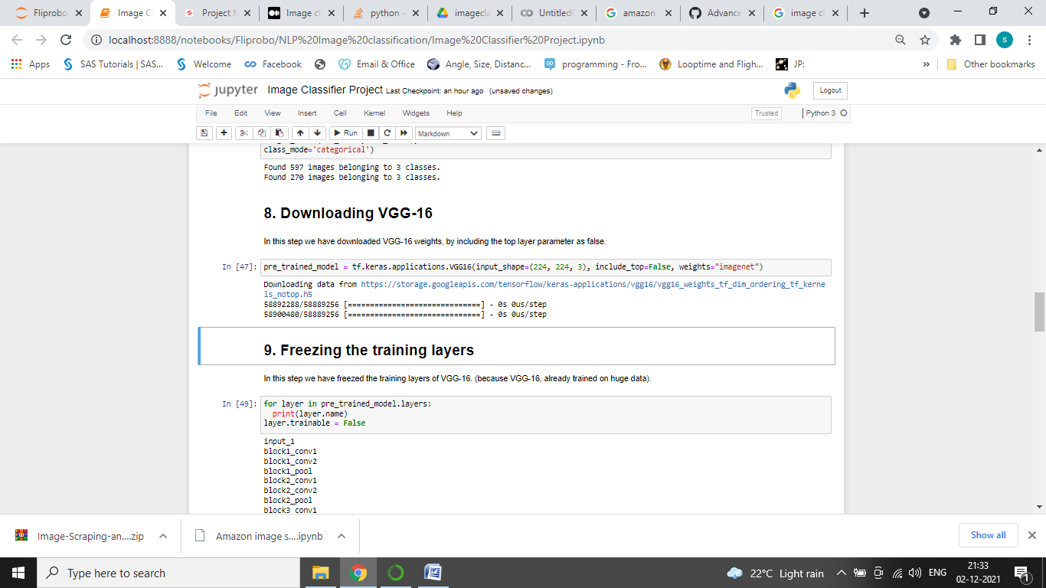
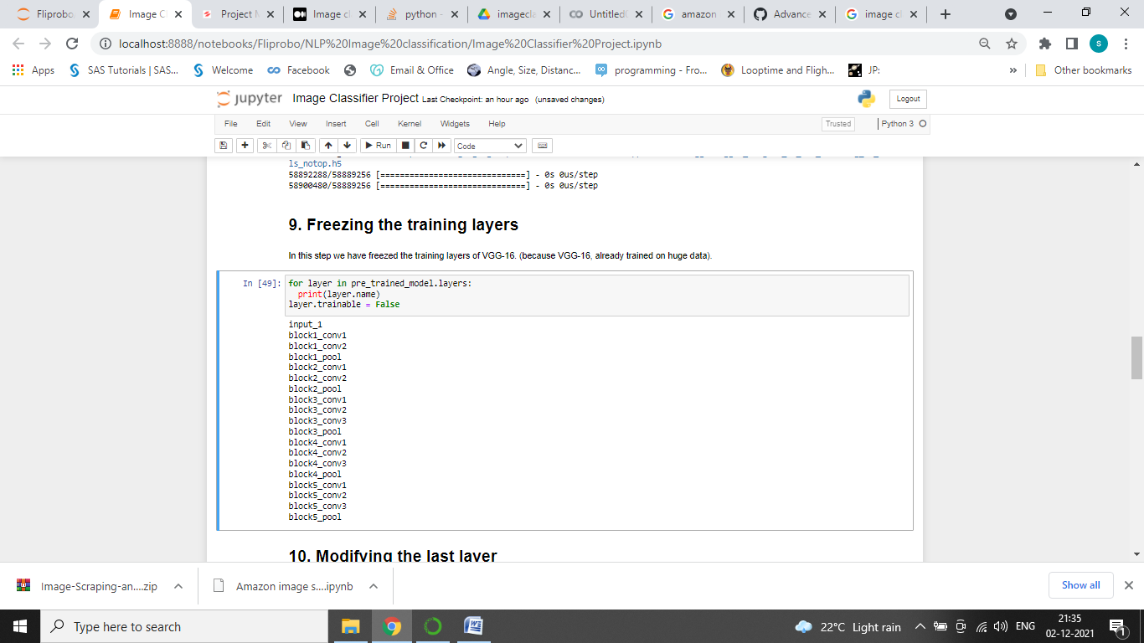
Data Pre Processing.
Downloading VGG-16:
Freezing the training layer:

Slide 6
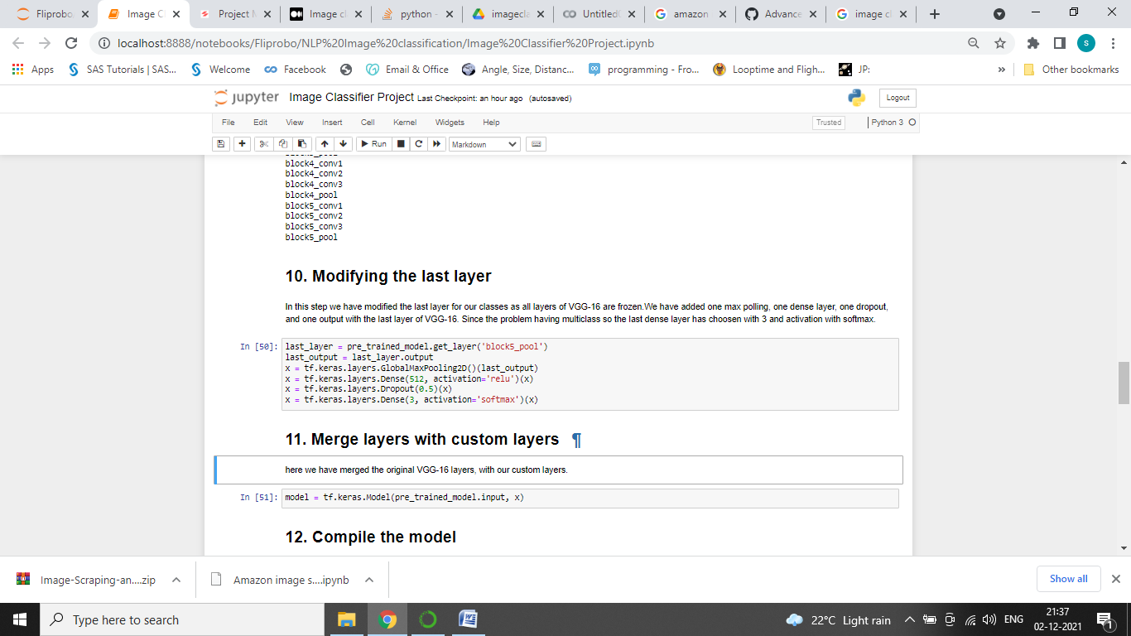
Data Pre Processing.
Following are the step followed for Data Pre processing in the dataset:
Modifying the last layer:

Slide 7
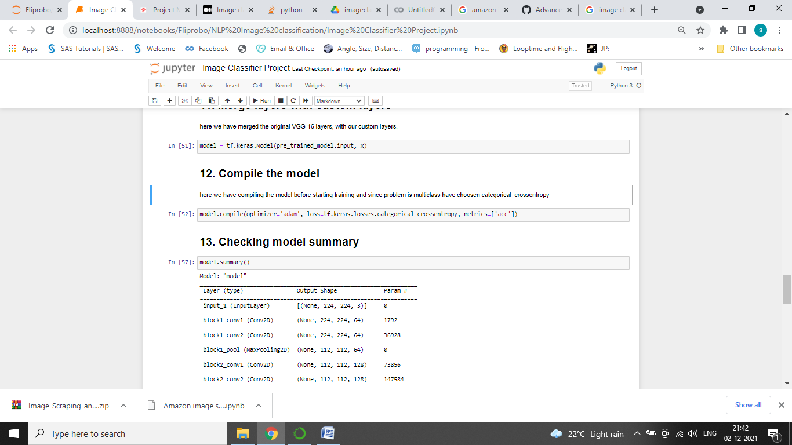
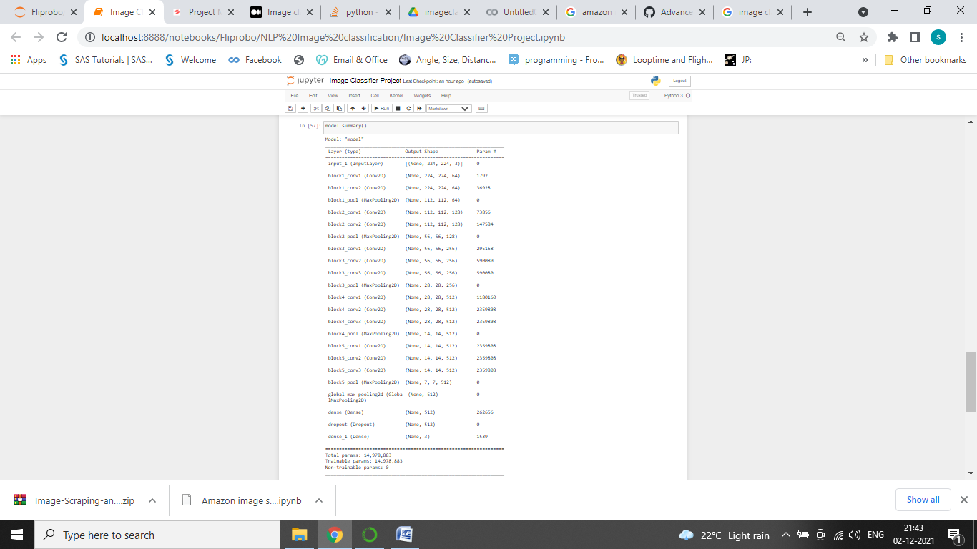
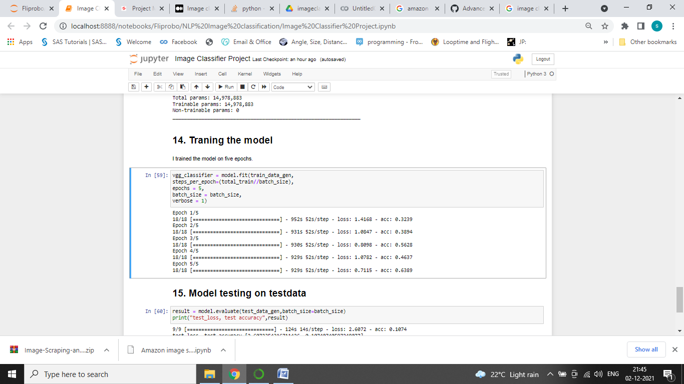
Model Development
here we have compiling the model before starting training and since problem is multiclass have chosen categorical_crossentropy and checking model summary.

Slide 8
Conclusion
Collecting the image data from website, where after scraping data would be not in proper format.
Our data are in image type so have applied image generator for uploading the data into the model.
We have trained the model and test the model in testing dataset.

Slide 9
THANK YOU

